Slide 1
MLA HELPER
Submitted by
SHAMNAMOL ALIYAR

Slide 2
ABSTRACT
The MLA Helper website provides basic information of mlas in kerala. Italso gives the information of MLA’s. The users can view districts,constituencies and complaint status
They can view information of MLA. Administrator has the full control of the website. The users can view address, mobile number and email id of MLA’s.
The MLA details are available in the siteThe website provides information about events and committee meeting details. The website provides a great opportunity for users to interact with the MLA’s

Slide 3
This help to solve their problems easily. The online registration is available.
Users have the option to post their forums and MLA replies, if their problem is solved. The MLA Helper website is really helpful for the MLA’s,and users

Slide 4
Module
Admin
Administrator has the full control of the website.
Administrator requires the following functionalities such as mla,constituency,fund allocation to MLA
Admin can view scheme to MLA, Local Area Development, Estimate Cost Approval,Fund To MLA,Fund usage , Complaint,Request
Admin can genereate Yearly/Monthly Report . Administrator can view the users and can remove the user from system.

Slide 5
2.MLA module
MLA requires the following functionalities such as user , fund approval, eventmanagement, Appointment approval, complaint approval.
mla can view requests and complaints of the user. mla take necessary action for the requests and complaints.
View Fund To MLA,Fund usage, Appointment,Complaint, Request,User Register, Complaint Register, Feedback,Answer To Question.
Question,Get monthly/yearly complaint report..MLA gets mobile alert message when he has any programme.

Slide 6
3. User module
The users can view the local area development projects and schemes of MLA’s. Send Feedback, Complaint Registration , Request To MLA, Ask Question Appointment Request , MLA fund usage.
User can View complaint Status, Request Status.
Users have the option to post their forums and MLA replies.
Users get a notification, if their problem is solved.

Slide 7
Building tools are :
Netbeans
GITHub
Apache Tomcat 7.0.34.0

Slide 8
JSP
JavaServer Pages (JSP) is a technology that helps software developers create dynamically generated web pages based on HTML, XML, or other document types. Released in 1999 by Sun Microsystems,^{[1]} JSP is similar to PHP and ASP, but it uses the Java programming language.
To deploy and run JavaServer Pages, a compatible web server with a servlet container, such as Apache Tomcat or Jetty, is require

Slide 9
Netbeans
NetBeans IDE is a free, open source, integrated development environment (IDE) that enables you to develop desktop, mobile and web applications.
The IDE supports application development in various languages, including Java, HTML5, PHP and C++. The IDE provides integrated support for the complete development cycle, from project creation through debugging, profiling and deployment.
The IDE runs on Windows, Linux, Mac OS X, and other UNIX-based systems.

Slide 10
The IDE provides comprehensive support for JDK 7 technologies and the most recent Java enhancements. It is the first IDE that provides support for JDK 7, Java EE 7, and JavaFX 2.
The IDE fully supports Java EE using the latest standards for Java, XML, Web services, and SQL and fully supports the GlassFish Server, the reference implementation of Java EE.

Slide 11
GitHub
Version control is a system that manages changes to a file or files.
These changes are kept as logs in a history, with detailed information on what file(s) was changed, what was changed within the file, who changed it, and a message on why the change was made.
This is extremely useful, especially when working in teams .

Slide 12
To understand how incredibly powerful version control is,:
How many files of different versions of a manuscript or thesis do you have laying around after getting feedback from your supervisor or co-authors?
Have you ever wanted to experiment with your code or your manuscript and need to make a new file so that the original is not touched ?
Have you ever deleted something and wish you hadn’t ?
Have you ever forgotten what you were doing on a project ?
All these problems are fixed by using version control (git)!

Slide 13
Apache Tomcat
Apache Tomcat, often referred to as Tomcat Server, is an open-source Java Servlet Container developed by the Apache Software Foundation (ASF).
Tomcat implements several Java EE specifications including Java Servlet, JavaServer Pages (JSP), Java EL, and WebSocket, and provides a "pure Java" HTTP web server environment in which Java code can run.
Tomcat is developed and maintained by an open community of developers under the auspices of the Apache Software Foundation, released under the Apache License 2.0 license, and is open-source software.

Slide 14
BUGZILLA
Bugzilla is an open-source issue/bug tracking system that allows developers effectively to keep track of outstanding problems with their product. It is written in Perl and uses MYSQL database.
Bugzilla is a Defect tracking tool, however it can be used as a test management tool as such it can be easily linked with other Test Case management tools like Quality Center, Testlink etc.
This open bug-tracker enables users to stay connected with their clients or employees, to communicate about problems effectively throughout the data-management chain.

Slide 15
Key features of Bugzilla includes
Advanced search capabilities
E-mail Notifications
Modify/file Bugs by e-mail
Time tracking
Strong security
Customization
Localization

Slide 16
Existing System
In the existing system, it is completely managed by pen and paper work .
This system is time consuming and it has lot of drawbacks. It must require a lots of time for enteringinformation into a record and also for searching mechanism.
It is completely depends on paper and pen work.Because of this reason editing updating and correcting any data in the record is very difficult.

Slide 17
Proposed System
The proposed system used by the Administrator, MLA, and User. Since we have created a system in which all the people who are associated with a district are taken into account and could use the benefits of the system.
The main advantage here is that as it is automates all the details of the working and management of MLA.
The most striking feature is that there are different levels of authentication within this system.

Slide 18
For example, the administrators in the MLA have an ability to add the details and also the administrators can view.
Proposed system improves the system’s performance because the current system is based on manual processing while the proposed system is based oncomputer processing.

Slide 19
TABLES
Login table
Purpose: Used to store the login details
Primary key: Username
Column name | Data type | constraints
Username | Varchar(20) | Primary key
Password | Varchar(50) | Not null

Slide 20
2.userreg table
Purpose: Used to store the user registration details
Primary key: Uid
Colume name | Data type | Constraints | Description
Uid | Int(11) | Primary key | user id
Name | Varchar(50) | Not null | Name of user
Address | Varchar(50) | Not null | User address
Email | Varchar(50) | Not null | Email id
Age | Varchar(50) | Not null | User age
Pass | Varchar(50) | Not null | password
User | Varchar(50) | Not null | User name

Slide 21
3. Mlareg table
Purpose: Used to store the mla registration details
Primary key: mid
Colume name | Data type | constraints | Description
Mid | Int(11) | Primary key | Mla id
Name | Varchar(50) | Not null | Name of mla
Address | Varchar(50) | Not null | Mla address
Email | Varchar(50) | Not null | Email id
Age | Varchar(50) | Not null | Mla age
Cons | Varchar(50) | Not null | constituency
Pass | Varchar(50) | Not null | password
User | Varchar(50) | Not null | User name

Slide 22
4.Fund table
Purpose: Used to store the fund details
Primary key: fid
Colume name | Data type | constraints | Description
Fid | Int(11) | Primary key | Fund id
Mla | Varchar(20) | notnull | Name of mla
Fund | Varchar(50) | notnull | Fund amount
Place | Varchar(50) | notnull | Place name
Cons | Varchar(20) | notnull | constituency
Idate | Date | notnull | Issue date
Purpose | Varchar(50) | notnull | Purpose of fund

Slide 23
5. Message table
Purpose: Used to store the message details
Primary key: msid
Colume name | Data type | constraints | Description
Msid | Int(11) | Primary key | Message id
Little | Varchar(20) | notnull | Little of message
Message | Varchar(50) | notnull | Content of message
To | Varchar(20) | notnull | Sender
Frm | Varchar(20) | notnull | Receiver
Reply | Varchar(50) | notnull | Message reply

Slide 24
6. Appointment table
Purpose: Used to store the Appointment details
Primary key: aid
Colume name | Data type | constraints | Description
Aid | Int(11) | Primary key | Appointment id
Date | Varchar(50) | notnull | Appointment date
Time | Varchar(50) | notnull | Appointment time
To | Varchar(50) | notnull | Sender
Frm | Varchar(50) | notnull | Receiver

Slide 25
7. Eventtype table
Purpose: Used to store the event type details
Primary key: eid
Colume name | Data type | constraints | description
Eid | Int(11) | Primary key | Event id
Event | varchar | notnull | Event name
Venu | varchar | notnull | Event venu
Place | varchar | notnull | Event place
Time | varchar | notnull | Event time

Slide 26
UML Diagrams

Slide 27
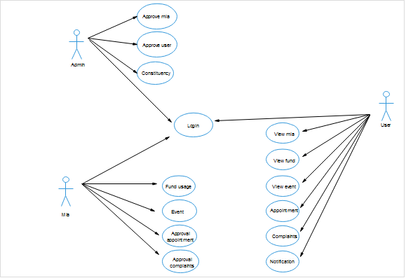
Use Case Diagram

Slide 28
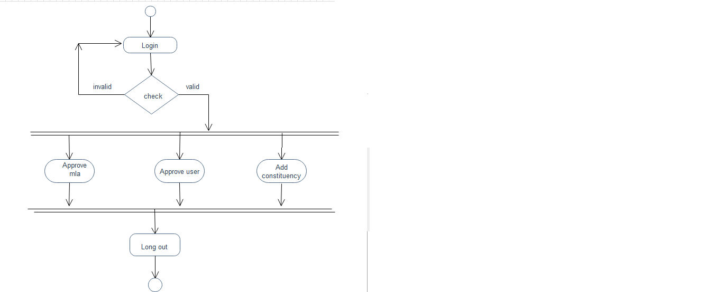
Activity Diagram
admin

Slide 29
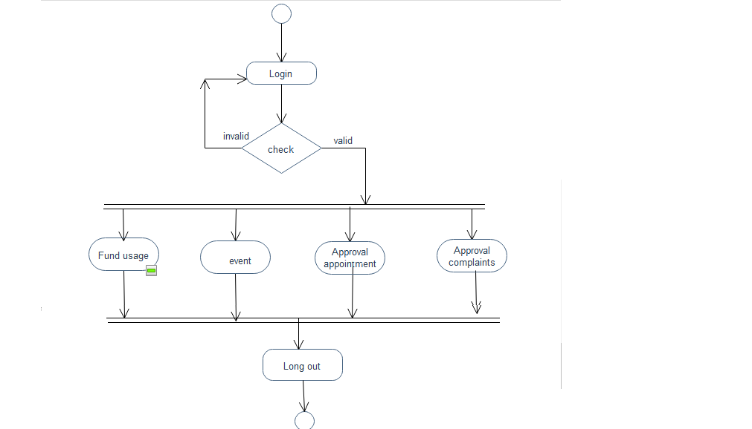
mla

Slide 30
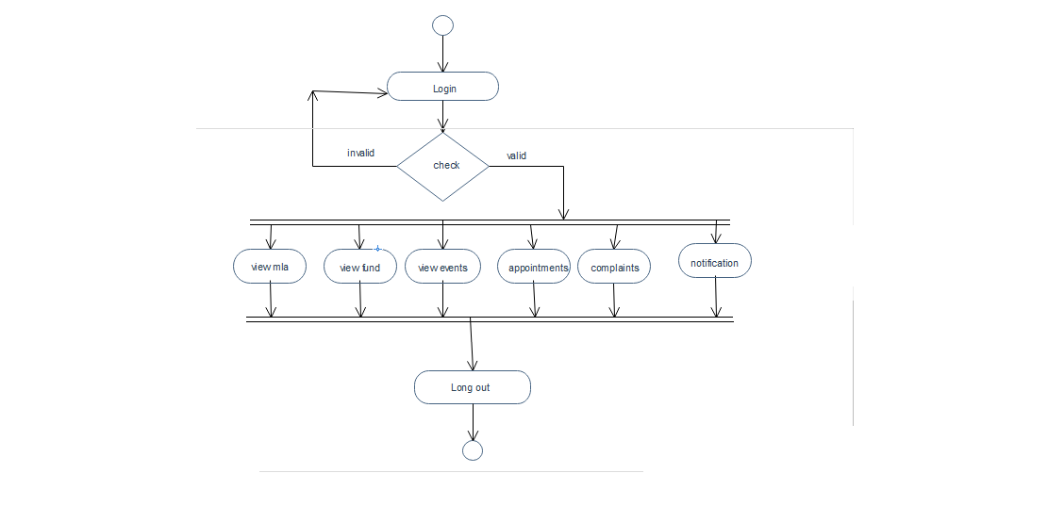
user

Slide 31
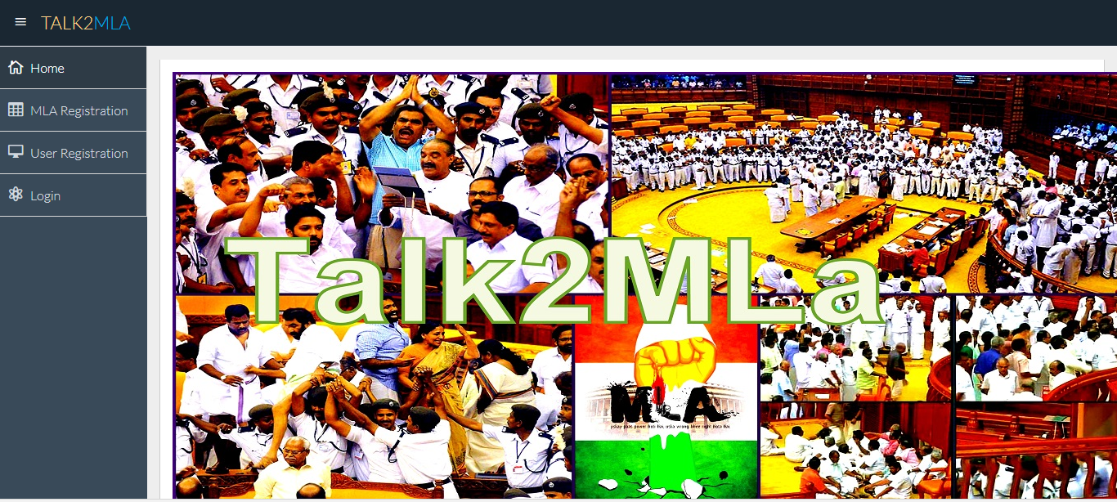
FORMS

Slide 32
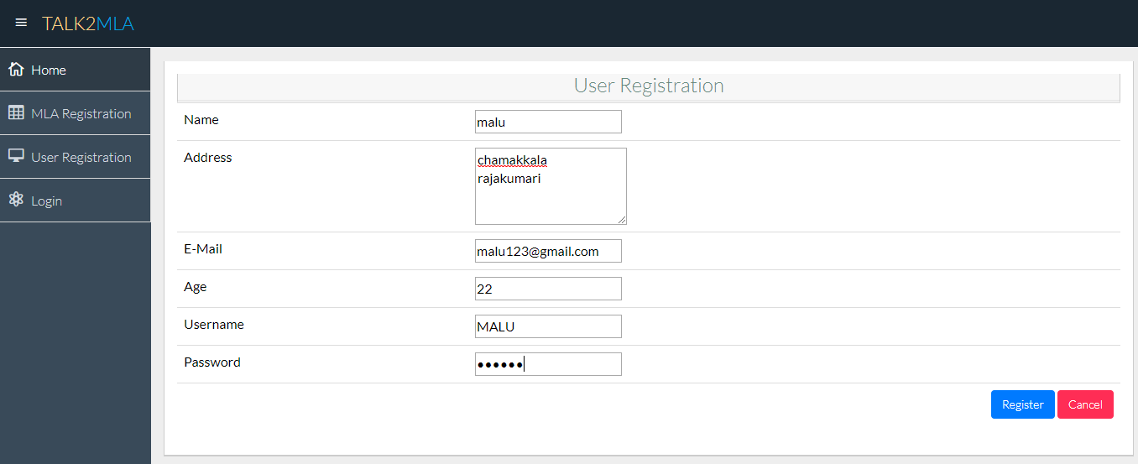
User registration

Slide 33
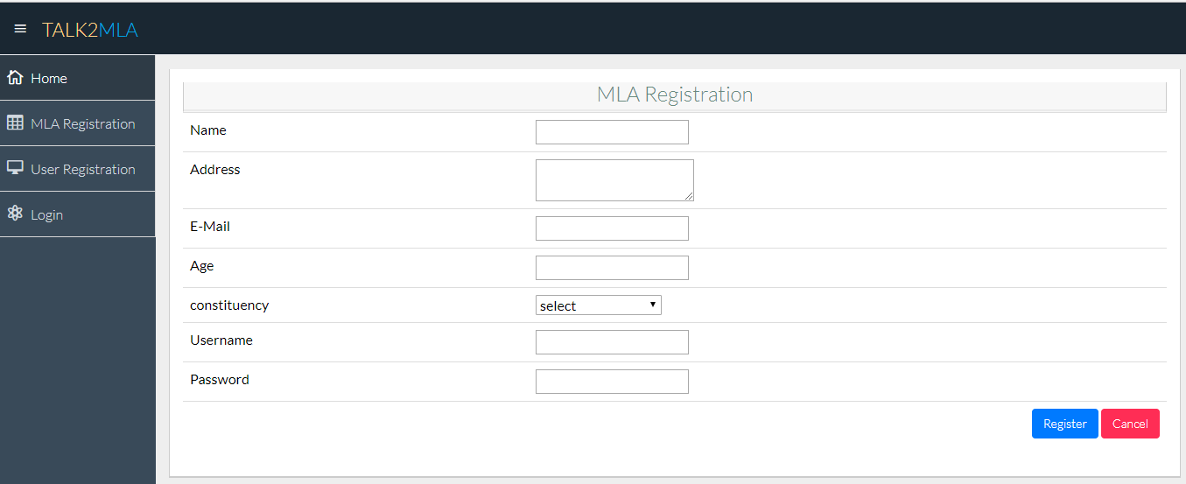
Mla registration

Slide 34
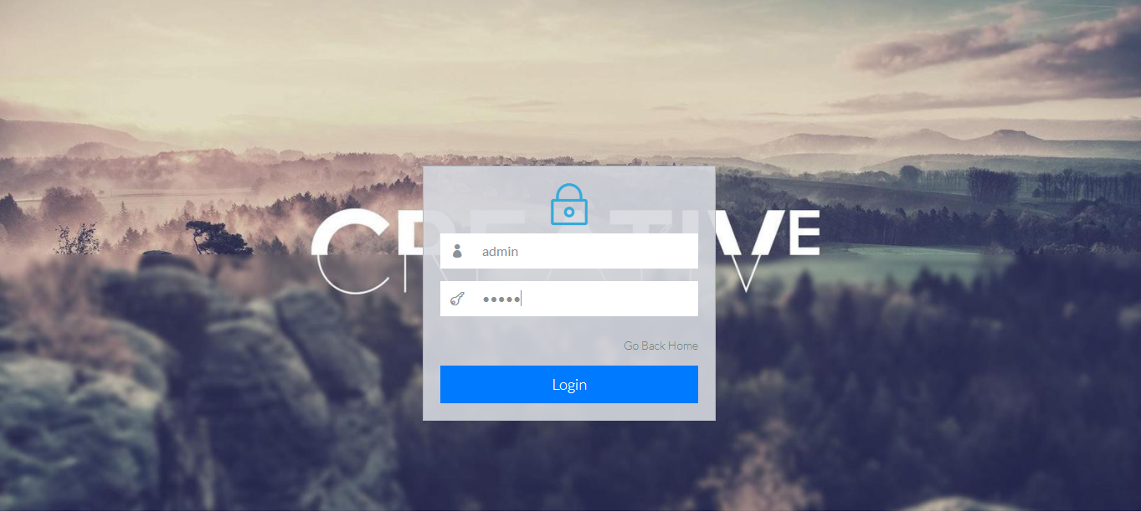
Admin login

Slide 35

Admin home page

Slide 36
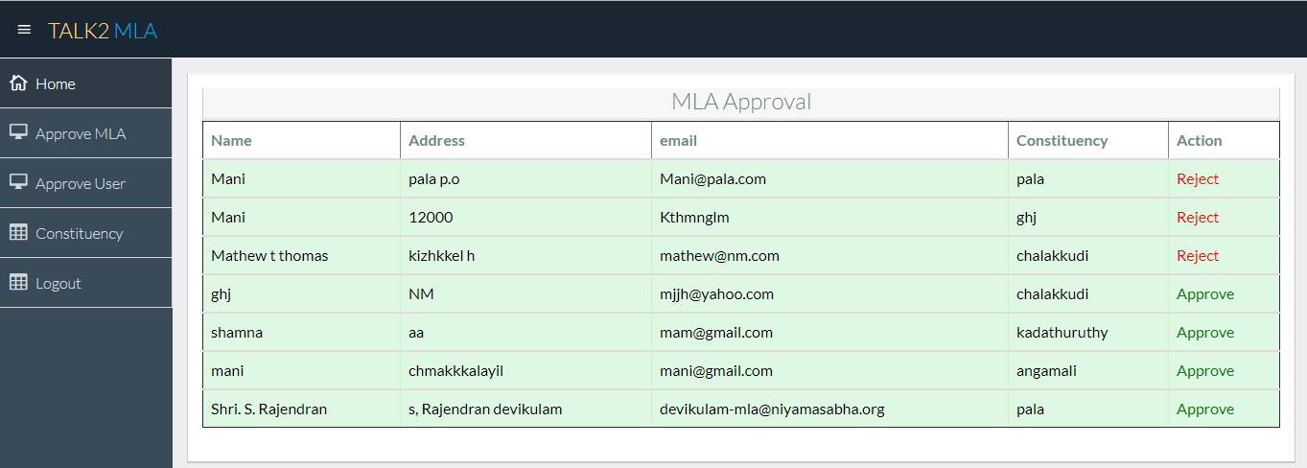
Mla Approval

Slide 37
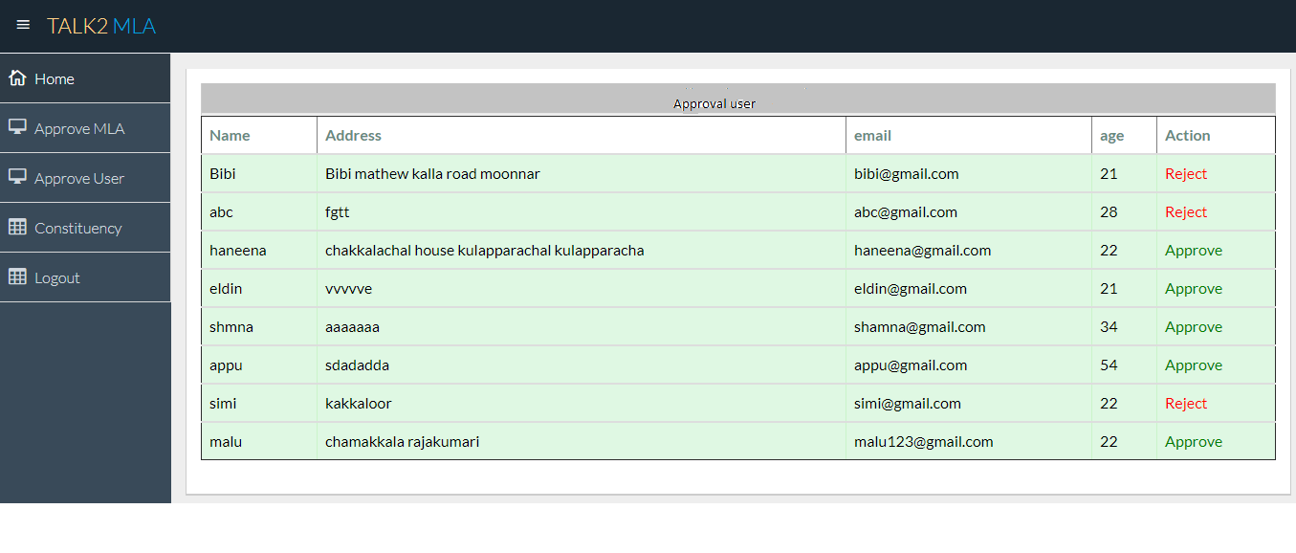
User Approval

Slide 38
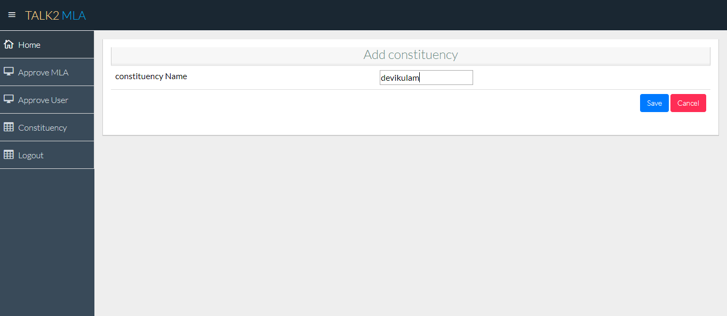
constituency

Slide 39
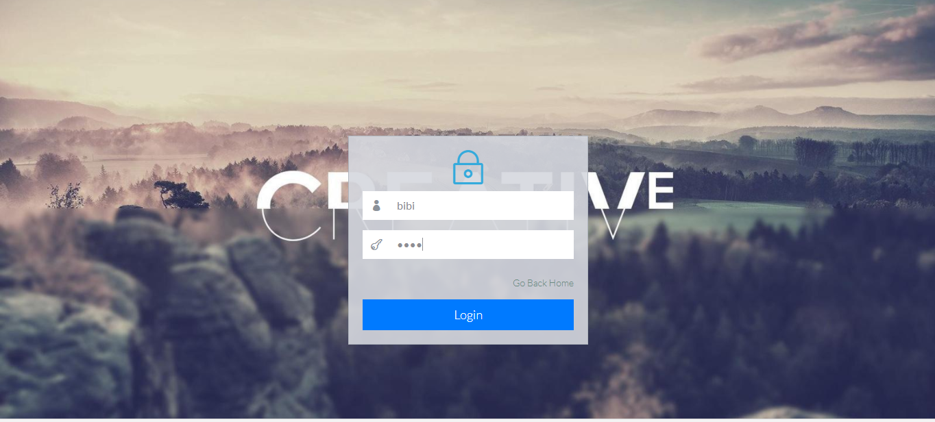
User login

Slide 40
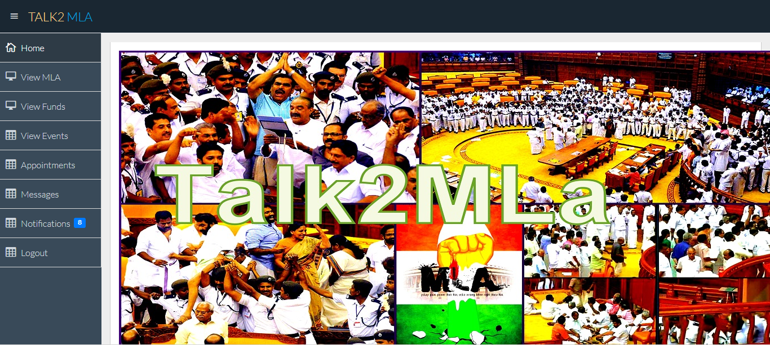
User home page

Slide 41
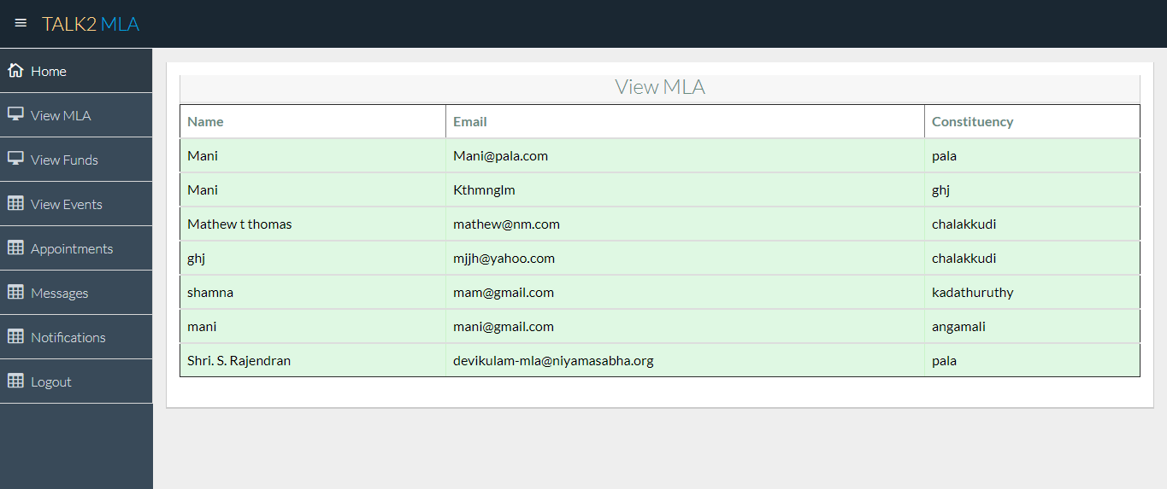
View mla

Slide 42
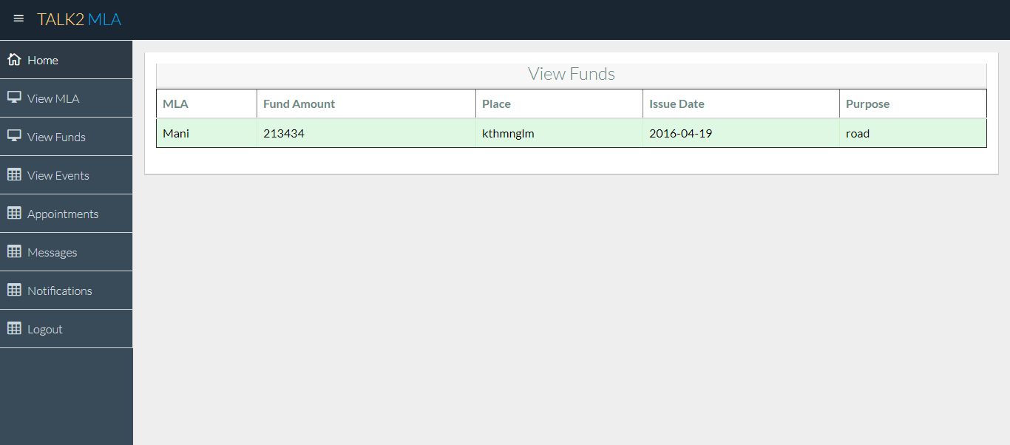
View fund

Slide 43
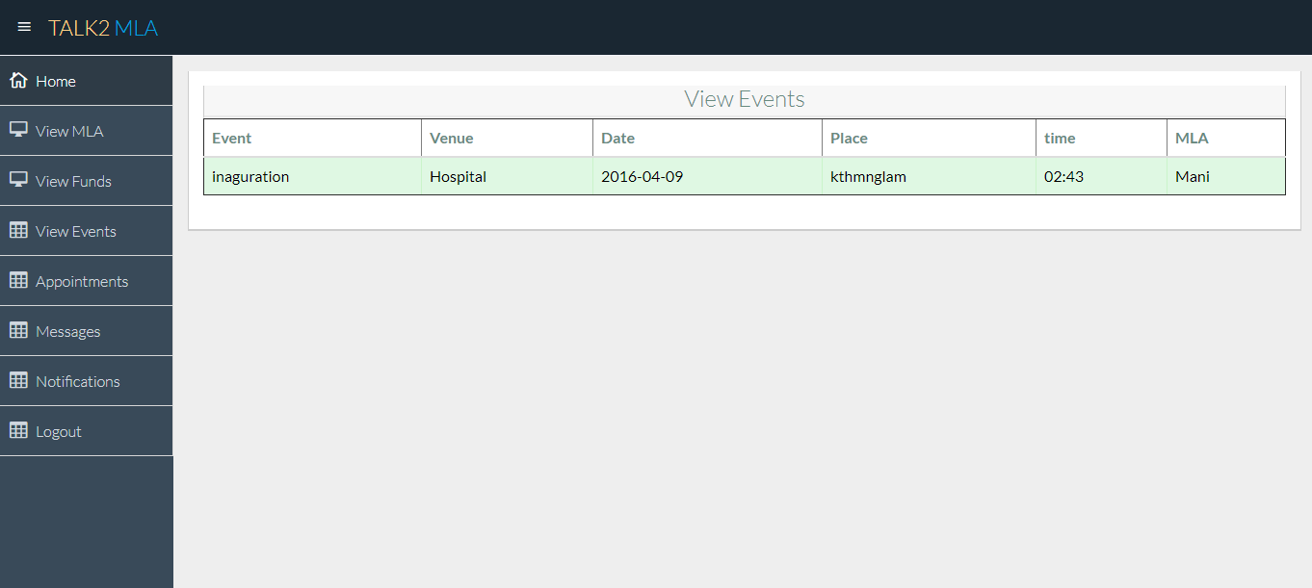
View events

Slide 44
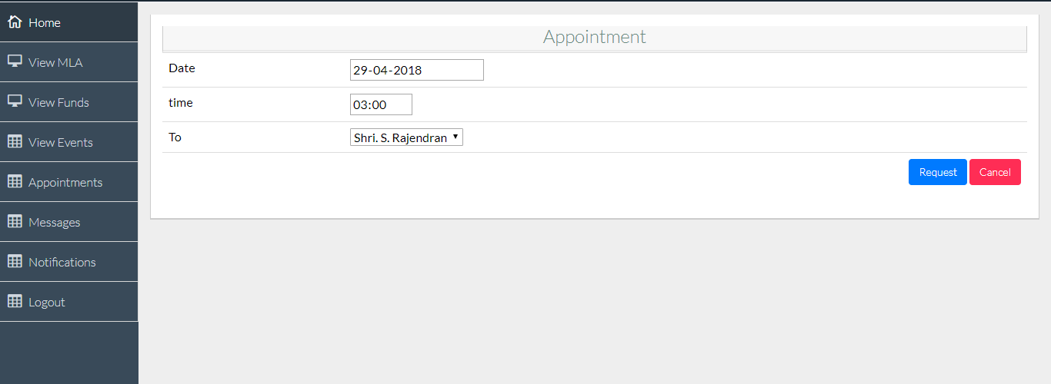
Appointment

Slide 45
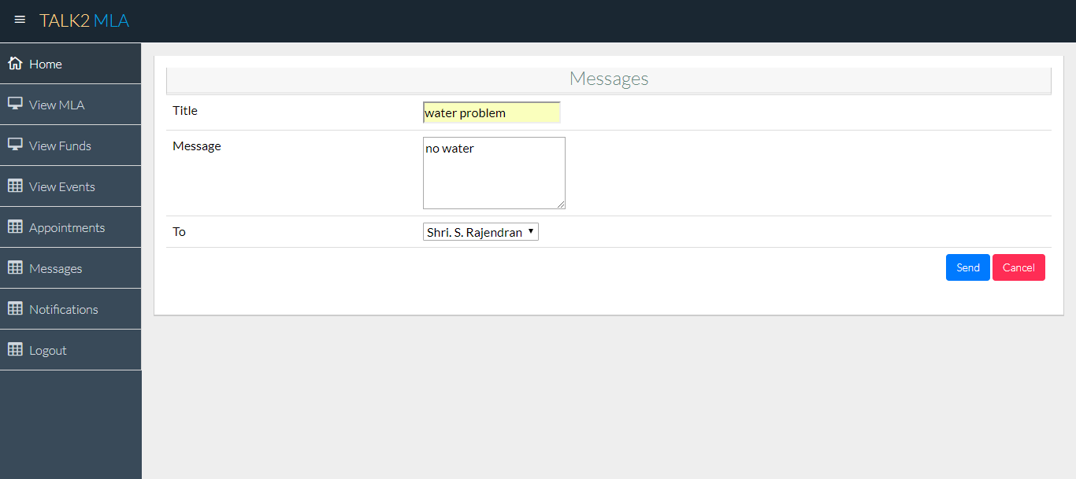
User msg

Slide 46
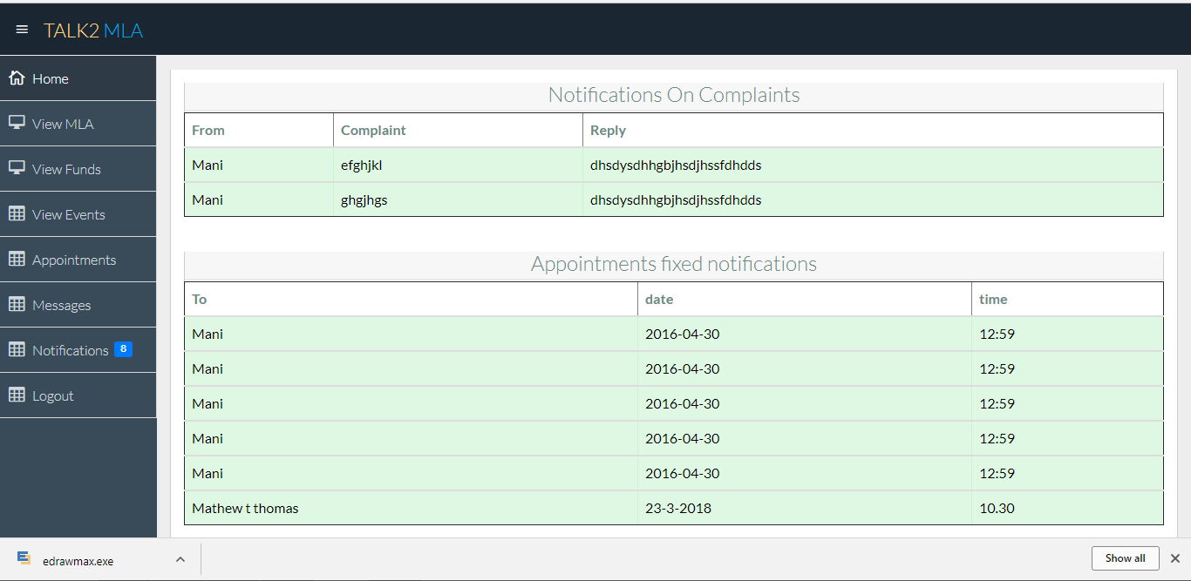
Notification

Slide 47
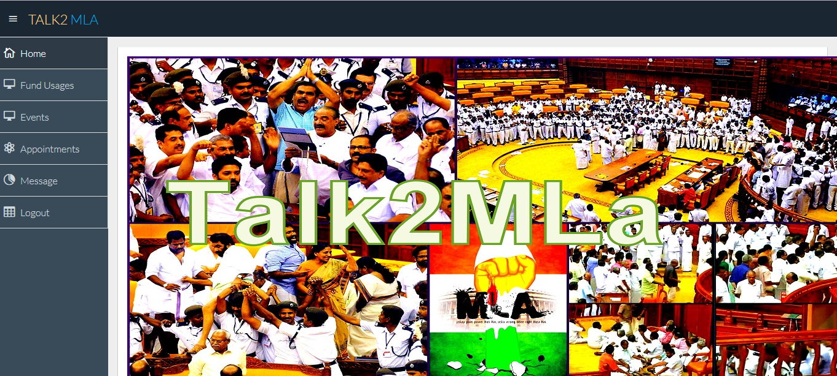
MLA HOME PAGE

Slide 48
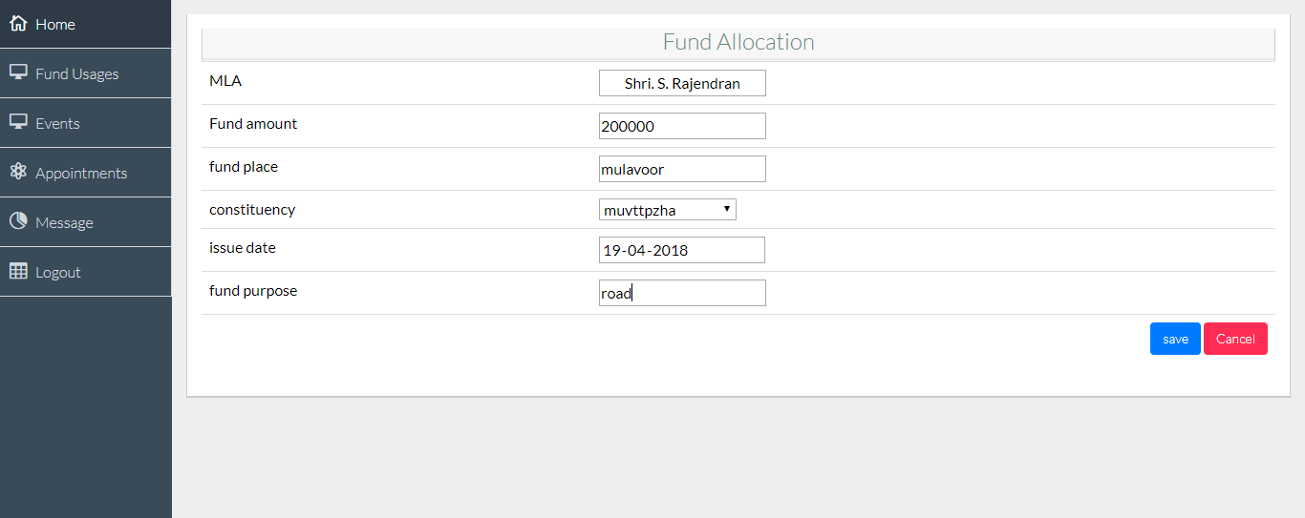
Fund allocation

Slide 49
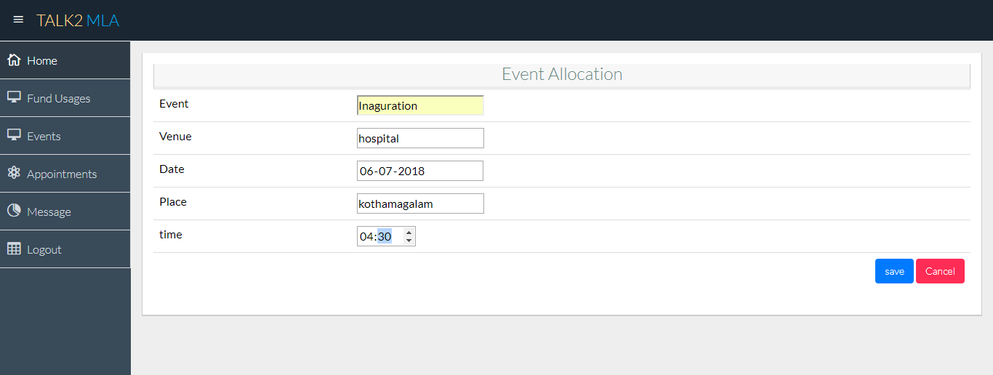
event

Slide 50
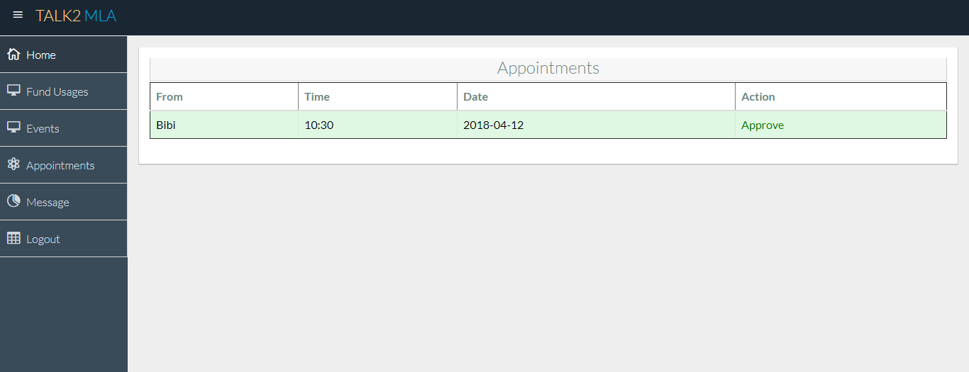
Appointment

Slide 51
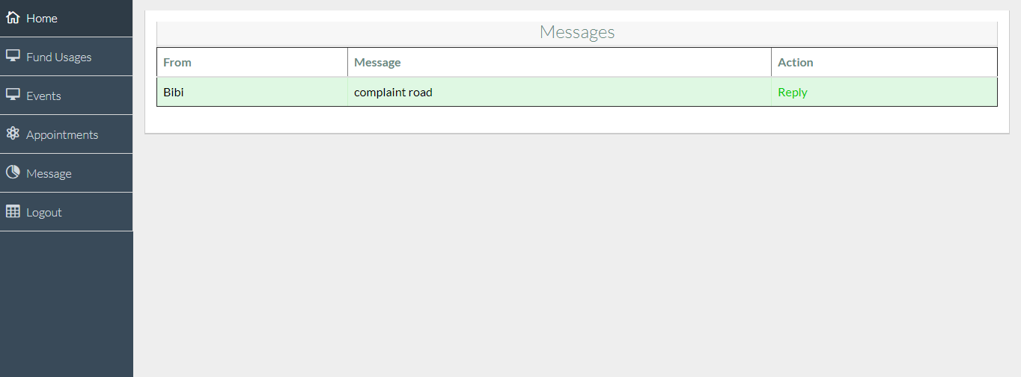
message

Slide 52
Thank you

